Slide 1
Seminar on Current Trends in SE
<number> of <number>

Slide 2
Definition
An occasion when an expert and a group of people meet to study and discuss something.
A meeting of group of people with teacher or expert for training, discussion, or study on a particular subject.
A gathering of people for the purpose of discussing a stated topic. Such gatherings are usually interactive sessions where the participants engage in discussions about the delineated topic.
<number> of <number>

Slide 3
Purpose of a Seminar
Seminar may have several purposes or just one purpose.
For the purpose of education, such as a lecture, where the participants engage in the discussion of an academic subject for the aim of gaining a better insight into the subject.
To inspire the attendees to become better people, or to work towards implementing the skills they might have learned from the seminar.
To network and meet other attendees with similar interests.
<number> of <number>

Slide 4
Techniques for Giving a Great Seminar
A set of suggestions and examples for creating good quality presentations.
Improve your ability to communicate your message.
What to do and
What not to do in your seminar!!
<number> of <number>

Slide 5
Goals of this Presentation
To demonstrate good principles for public presentations (mostly) using PowerPoint and computer projectors.
To show how to use slides effectively.
To demonstrate good and bad slides, distracting habits, and good and bad presentation techniques.
Some suggestions to enhance your ability to communicate your message to your audience.
To suggest some tips for a better presentation.
<number> of <number>

Slide 6
The Three Essential Features of a Good Presentation
Tell people what you are going to tell them.
Tell them the material.
Tell them what you told them.
Introduction & outline
Your core materials in
necessary detail
Summarize your findings
and close your presentation
<number> of <number>
Notes:
When you follow this rule, you get three chances to communicate your message. You need to have a clear outline so your audience has a good idea what you hope to achieve. Then you can dig down into your data and make your case. When you finished, you need to restate your case – this is your last chance to communicate your message. Different individuals will extract information at different levers from each of these three opportunities. Its also important to inform your audience where you are going in a presentation.

Slide 7
The basic rules of engagement
1. Be well prepared.
2. Speak clearly.
3. Keep to time.
4. Be aware of your audience.
<number> of <number>

Slide 8
Opening your presentation
You should be early (10 min) for your presentation.
You should have checked in with the person who will chair the session.
You should have already checked the room, projector and computer well before your talk.
You should be ready to begin when invited.
Your first slide should be on the screen before you begin.
It should have your presentation title on it and information about you.
<number> of <number>
Notes:
Don’t be late! While that might be obvious, you are really risking making a terrible presentation if you are stressed and discombobulated! If at all possible go to the presentation room and check out your computer, the podium, and check the screen. Scoping out the environment will give you confidence that you will be in good shape, or it will warn you of things you may not be able to change such as the fact that the screen is almost in front of the speaker and you may not be able to see it. Or, there is no room to place your notes and your computer (a very common problem in lecture rooms!!)….so that might tell you to change the format of your notes….. Also check out how you are going to manage your slides if you move away from the podium (which I don’t recommend if you are not very confident!)

Slide 9
Your Opening Statement
If you are an Invited Speaker:
  “Thank you very much for that generous introduction. I would like to thank the organizers for inviting me to give this presentation. It is an honor to be here at Purdue. Today I would like to present some ideas on the invention of the wheel.…”
If you are a Seminar Speaker (more informal):
  “Thank you very much Professor X. I am very glad to be able to give this seminar. Today I would like to present some ideas on the invention of the wheel.”
Your opening statement should be strong, and well prepared. It should be short and it can also be an expression of thanks to your host if appropriate.
<number> of <number>
Notes:
This is fundamental for all presentations where you are an invited speaker under any conditions! It’s the polite and correct thing to do and it’s a very easy way to gain credibility with your audience, start off with a strong statement and prepare your audience for a nice presentation. Your opening statement should be strong, and well prepared. It should be short and it can also be an expression of thanks to your host if appropriate.

Slide 10
Your Closing Statement
Do
“In my last slide I would like to acknowledge the participation of my university president, dean, director and Miss/Mr/Dr. X. I would also like to acknowledge the support of the university, School of computing.” (pause here very briefly) … “Thank you very much for your attention.” (Don’t say anything else!!!!)
Don’t
Don’t just stop!
Don’t say “that’s it”…. “that’s the end” ….: “I’m finished”
NEVER offer to answer questions if there is a chairperson - it is the role of the chairperson, not you, to ask for questions!!!! (Don’t invite questions - it’s not your job – you might have gone 15 minutes over and you still think you should answer questions?)
So: Make the audience feel comfortable about the end of your presentation by telling them when it is finished.
<number> of <number>
Notes:
Just remember that when you have finished your presentation it is important that your audience knows when you finish. If you are in the audience, you would like to be sure when the speaker is finished so that you can acknowledge the presentation in the appropriate way. Many speakers don’t give the courtesy to their audience by giving them a clear indication that they have finished.
When you have completed your presentation, please allow them to clap and cheer and give you a standing ovation if they must, you when you have finished. But, you have to let them know you are finished in a comfortable way (I mean for the audience not for you!!). I have heard literally dozens of speakers who, when they have finished their presentation stop, look around and say “That’s it” ….or worse, they present their last slide and immediately say “Are there any questions?” what happens after this person asks for questions? There is an awkward silence and some poor person starts to clap….then everyone starts to clap…..then the person on the dais stand there looking a little silly! It’s their own fault because they took over the role of the chairperson. Don’t do that. The only time this should ever happen is if the person giving the talk is also the chair of that session/lecture.

Slide 11
Key Material Items to Consider
The slide background.
Your personal habits.
Use of the laser pointer.
Use of color.
Use of animation tools.
Use of diagrams or flow charts.
Amount of material per slide.
Number of slides in the presentation.
Your first and last slides.
<number> of <number>

Slide 12
Your personal habits
Standing: Face your audience, but if you are very nervous, look only at people in the middle or back rows.
Pacing/walking: Sometimes pacing helps when you are nervous – it can also help to keep the audience’s attention – but it can also be distracting – if you pace, pace slowly and deliberately.
Speech: Speak slowly, clearly, & deliberately
  Don’t say “Ummm”…or “Ah….”….between every sentence
  Don’t say “You know….” when you pause – silence is better!!
  If English is not your native language, you must speak slowly or you may risk failure to communicate!!!
Fidgeting(Playing): Don’t play with the toys (like keys) or put your hands in your pockets and jiggle keys – hold the lectern if you have to. This might give you some additional confidence.
Humor/comedy: Use very sparingly, it can be an ice-breaker but it is very hard to do – my suggestion is to avoid it.
<number> of <number>
Notes:
The personal habits of the speaker are really important. Remember, that you are standing in front of an audience for 40 minutes to an hour. You are the center of attention. All eyes are focused on you. Everything you do will be observed. If you do something often enough you will start to annoy someone. For example, how many times have you see a speaker face the screen and never look at the audience? Alternatively, have you seen someone walk all over the place making you wonder where they are going next? Or perhaps you are wondering if they are going to fall down the step at the edge of the stage because they are getting closer and closer?
How about that speaker that says at the end of every sentence :You know what I mean”? Or the speaker that says “Ummmm” or “Ahhh” just hundreds of times. So many that you start to count them and by the end of the presentation, you notes contain little hatch marks with the number and you have no idea what they said. Don’t look down at your notes and say “let me see, where was I, did that did that…..oh yes here I am” If you don’t have something valuable to say, don’t say it.
Don’t put your hand in your pockets and play with your keys! Yes I have see that happen many times. Don’t click a pen constantly, and don’t tap the pointer stick on the floor!
If you make a joke, do it quickly, sparingly and don’t push it! Humor is something best left for professionals…even they have trouble keeping a job!

Slide 13

Pointer hints for nervous people
(that’s most people actually!)
Hold the lectern when you talk – it stops your hands doing funny things. When you become more confident, you can walk away from the lectern.
Hold the laser pointer on the edge of the lectern when you point it – then your quivering fingers won’t make the pointer bounce everywhere!!
<number> of <number>

Slide 14

Fonts
Try to use a single, clear font across the entire presentation.
Make the text large enough that the audience can read it.
Some fonts are really bad.
Some are worse.
And some should be avoided at all costs.
Note: You might think that your science is a work of art, but the art is in the science not the art.
<number> of <number>

Slide 15
Using Backgrounds
Backgrounds are fun, but they can be distracting.
Sometimes you cannot read the text.
Sometimes backgrounds are more interesting than the data.
They significantly increase the size of the file.
Sometimes they just look ridiculous.
It is a well known fact that the most important factor in reading text is …..contrast.
The best contrast is……Black and white.
So: Sometimes boring old black and white slides are easier to see and can be effective in communicating your message!! !!
<number> of <number>
Notes:
Contrast is the most important feature of slides. If you have good contrast the audience can usually read the slide. If you have a complex color background, you will probably reduce the contrast making it harder, not easier for the audience to read your slides. If you know that the theater you are presenting in will be very large, you are far better at making a high contrast presentation even in black and white.
Just remember, that if you make a pretty background, it might look so good that your audience missed the data in your slide!

Slide 16
,,, Cont’d
Be careful when using backgrounds available from templates.
A more conservative approach is safer.
You want the audience to focus on your data, not your background.
If you must, use a simple color like blue.
Some examples follow in the next 5 slides – the last 2 are not acceptable.
<number> of <number>

Slide 17
What Resources are Required?
Start with educational objectives and goals
Define needs based only on the educational objectives
Initially identify minimal hardware requirements, beg or borrow if necessary
Integrate staff into lab with scientific staff to increase participation
So: Very plain example slide. No frills. Not exciting - but clear
<number> of <number>
Notes:
Remember you only have a short period of time to get your message across so list out the key features only.
The above slide defined 4 simple points, each of which you could expand easily. This slide is monochrome and is a very simple slide. There are few enough points on the slide that you can bring all the points up at one time, rather than bringing each line using a fancy animation.

Slide 18
What Resources are Required?
Start with educational objectives and goals
Define needs based only on the educational objectives
Initially identify minimal hardware requirements, beg or borrow if necessary
Integrate staff into lab with scientific staff to increase participation
So: Good example slide (logo and top bar work OK) Colors are muted and tasteful
Notes:
Here is the same slide jazzed up a little. It uses a standard PowerPoint background, but one that is not overly colorful or complicated. I tend to go for these slide backgrounds because they keep the text mostly black on a white background which as we already discovered give the maximum possible contrast.

Slide 19
What Resources are Required?
Start with educational objectives and goals
Define needs based only on the educational objectives
Initially identify minimal hardware requirements, beg or borrow if necessary
Integrate staff into lab with scientific staff to increase participation
So: Good example slide (side/top bar work OK) Colors are fine, note slide number on left.
Good example slide –top and side bar
Notes:
This is similar to the previous slide, but has some text color. Sometimes a gentle color is pleasant and quite acceptable, but you have to be careful.

Slide 20
What Resources are Required?
Start with educational objectives and goals
Define needs based only on the educational objectives
Initially identify minimal hardware requirements, beg or borrow if necessary
Integrate staff into lab with scientific staff to increase participation
So: BAD example slide - nasty background – it’s very distracting and much more interesting than the text!!
BAD , BAD slide !!
Notes:
Now we are getting very colorful. The primary difference in this slide is the reversal of the text color by placing a colorful background on the slide. It’s a nice picture, but it’s really too complicated and I don’t think this slide is a good one. I would not use this type of background unless my talk was about the sea perhaps!
The text is not easy to read. Using the shadow feature is rarely a good idea. It might be artistic, but it is not easy to read. Don’t make it hard for your audience to decipher what you have written.

Slide 21
What Resources are Required?
Start with educational objectives and goals
Define needs based only on the educational objectives
Initially identify minimal hardware requirements, beg or borrow if necessary
Integrate staff into lab with scientific staff to increase participation
So: VERY BAD example slide – drop the fireworks!
Notes:
This slide is OK, because the background is mostly black and the text is strong enough to give good contrast. I don’t think that the fireworks is particularly useful, although it might look pretty. This is more useful for a marketing talk at a sales conference than it is for a scientific presentation. Drop the fireworks, and it might be OK.

Slide 22
Use of Color
Color shows emphasis….BUT..
It should be used sparingly
Certain colors cannot be used together
  For example:
  Red text cannot be used on blue backgrounds or vice versa
  Blue text cannot be used on red backgrounds or vice versa
Colors that should virtually never be used are:
  Purple, pink and bright green
Yellow can be used on black but never on a white background
So: NEVER use red and blue together…it might look OK on your computer screen, but it’s horrible on the projector screen!!
<number> of <number>
Notes:
Don’t even think of using red and blue together! I have seen this so many times, it amazes me. It’s just horrible and should never be used. Avoid using lots of colors. It really does not enhance your presentation.

Slide 23
The difference between your computer screen and the projector screen
Colors that look great on your computer screen may be TERRIBLE on the projector screen.
For example BLUE background CANNOT have black text.
White Text looks better on dark
backgrounds
Black Text looks fine on your
Computer screen
Black Text looks fine on your
Computer screen
Your computer SCREEN looks like
this….It’s just OK.
But this is what happens when it is
projected onto the screen….
So: NEVER use black text on a blue background…it might look OK on your computer screen, but the audience can’t read it!!
<number> of <number>

Slide 24
Animation
How much animation is right?
Make sure you test it carefully!
A small amount of animation is good
Too much is “ditzy” and can annoy your audience
If you annoy your audience, you don’t communicate
So: “Ditzy” animations are really off-putting to the audience. Good animations, such as how reactions takes place, are fine.
<number> of <number>

Slide 25
Advantages
Standard Assay
Uses whole blood
Cheaper than microdrop
Gel Microdrop
Rare populations
Short incubation
Sort and recover live cells
This is not a good slide….
So: EXAMPLE: bad color, way too much animation – it’s just a bad slide
Notes:
This is a slide I borrowed from a student presentation in a class that I teach.
This student used a vast number of animation sequences. In addition, the red and green text are just nasty! Don’t be fooled into thinking that color makes a badly prepared presentation more acceptable.
If I were rating this slide from 1-10 where 10 was an excellent slide, this would definitely be a 1 or 2.

Slide 26
Advantages
Gel Microdrop
Rare populations
Short incubation
Sort and recover live cells
Standard Assay
Uses whole blood
Cheaper than microdrop
So: OK – it might look boring, but this is a very basic slide and really does not need any enhancement. Audience is focusing on the text.
<number> of <number>
Notes:
This is the opposite of the previous slide. It is monochrome and there are virtually no distracting features. The simple lines demarcate the two sections, and the message is clear. Its not pretty, but the message is very clear.

Slide 27
Advantages
Standard Assay
Uses whole blood
Cheaper than microdrop
Gel Microdrop
Rare populations
Short incubation
Sort and recover live cells
So: If you want to make it a little more attractive…this works well.
Notes:
This slide is a compromise for those who love color. It’s gentle but has a few nice curved lines. It is simple and allows the observer focus on the text. If you used these slide backgrounds, you need to be careful in placing the title text in the center of the blue area. If it is not well placed, it may make the slide look quite imbalanced and draw peoples attention to the inconsistency rather than on the key features.

Slide 28



Hydrodynamically focused fluidics
Signal
Increase pressure:
Widen core
Increase turbulence
So: you have to explain each step in the process – this animation needs some time to do that – and the star on the right indicates how many mouse clicks to perform the entire animation sequence – add stars for each click necessary and animate them to disappear at each click
<number> of <number>

Slide 29
Use diagrams or flow charts if possible
Blocker 1
First Reactant
Intermediate
Last Reactant
Reagent A
Reagent C
Reagent B
Note the stars indicating the number of mouse clicks left…
So: Simple – straight-forward animation is good
<number> of <number>

Slide 30
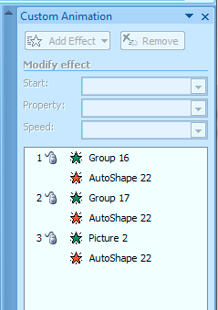
Animation helper
Place a small icon on the bottom of the screen to tell you how many steps there are in your animation.
+
=
So: Note the stars indicating the number of mouse clicks left…this helps to remind you of how many animation steps you have
<number> of <number>

Slide 31

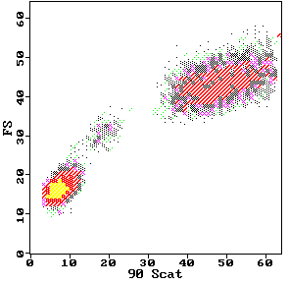


Example
DCFH-DA DCFH DCF
2’,7’-dichlorofluorescin diacetate
O
O
CH3-C-O
O
O-C-CH3
Cl
Cl
2’,7’-dichlorofluorescin
H
COOH
HO
O
OH
Fluorescent
Cellular Esterases
Cl
Cl
H
COOH
2’,7’-dichlorofluorescein
Hydrolysis
HO
O
O
H₂O₂
Cl
Cl
DCFH-DA
Oxidation
H
COOH
Neutrophils
DCFH-DA
80
Monocytes
Control
PMA-stimulated PMN
60
DCFH
H O
counts
2 2
40
Lymphocytes
20
DCF
0
.1
1
10
100
1000
log FITC Fluorescence
So: This is pretty complex – it needs a long time to explain.
<number> of <number>

Slide 32

How a line scanning confocal works
A
Beam-splitting lens
C
1
1
2
2
3
Laser out
3
460 nm
405/35 nm
0.8
Ratio: intensity1 (460nm) / intensity2 (405/35nm)
Cells in tissue culture disk are imaged on
an inverted microscope stage
D
0.7
0.6
0.5
0.4
Scan width can be adjusted
Note that laser light is delivered
via a standard objective.
0.3
0.2
0.1
0
B
0
50
100
150
200
Laser in
So: This is simple – it is very straightforward – explanation is easy.
<number> of <number>

Slide 33

Rat neutrophil oxidative burst
with nitric oxide modulators
12
Bars represent 1 SD mean
d
d
a
a
a,b,c,d
represent
statistical
significance
levels
8
a
4
b
c
0
HBSS
HBSS
TNFα
L-arg
L-arg
TNFα
L-NMMA
L-NMMA
TNFα
NO modulators increase superoxide, TNF reduces O₂⁻
So: Basic data, very, very simple. A no-frills slide
<number> of <number>

Slide 34
Rat neutrophil oxidative burst
with nitric oxide modulators
12
Bars represent 1 SD mean
d
d
a
a
a,b,c,d
represent
statistical
significance
levels
8
a
4
b
c
0
HBSS
HBSS
TNFα
L-arg
L-arg
TNFα
L-NMMA
L-NMMA
TNFα
NO modulators increase superoxide, TNF reduces O₂⁻
So: Basic data, but color enhanced…careful tho’ not to confuse what you are trying to explain. Do the colors add value to the data?
<number> of <number>

Slide 35
Rat neutrophil oxidative burst
with nitric oxide modulators
12
Bars represent 1 SD mean
d
d
a
a
a,b,c,d
represent
statistical
significance
levels
8
a
4
b
c
0
HBSS
HBSS
TNFα
L-arg
L-arg
TNFα
L-NMMA
L-NMMA
TNFα
NO modulators increase superoxide, TNF reduces O₂⁻
So: Be careful when you use enhancement features. This is OK, but much more would become very distracting.
<number> of <number>

Slide 36
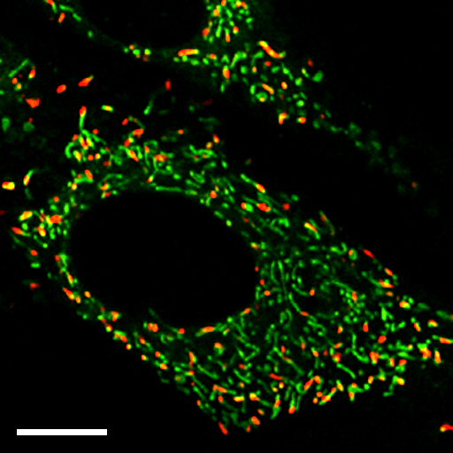
Rat neutrophil oxidative burst
with nitric oxide modulators
This is a useless
and distracting
piece of this slide
Background is
weird!!
12
d
8
a
a
a
Mean EB Fluorescence
4
b
c
0
HBSS
HBSS
TNFα
L-arg
L-arg
TNFα
L-NMMA
L-NMMA
TNFα
NO modulators increase superoxide, TNK reduces O₂⁻
Pinhole 1
Pinhole 2
Specimen
Detector
Condenser
Lens
Objective
Lens
So: This is overboard – background is horribly distracting, and it’s just a bad slide. The audience is wincing…..it’s not acceptable!!

Slide 37
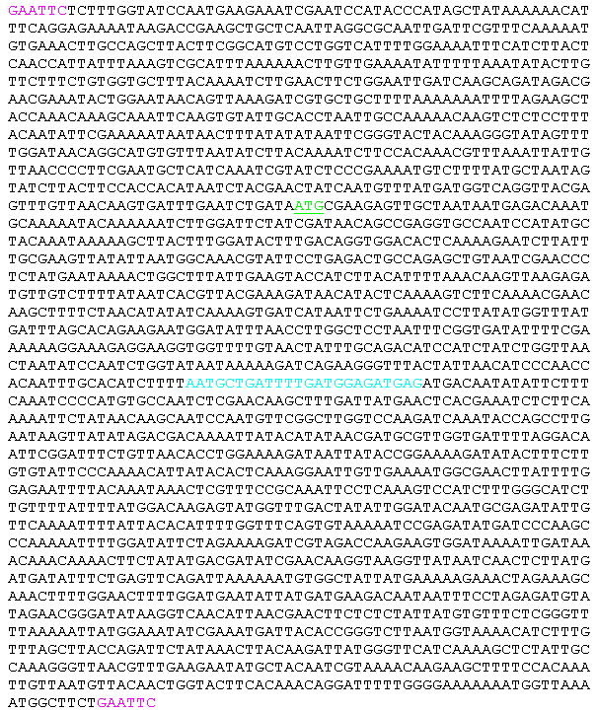
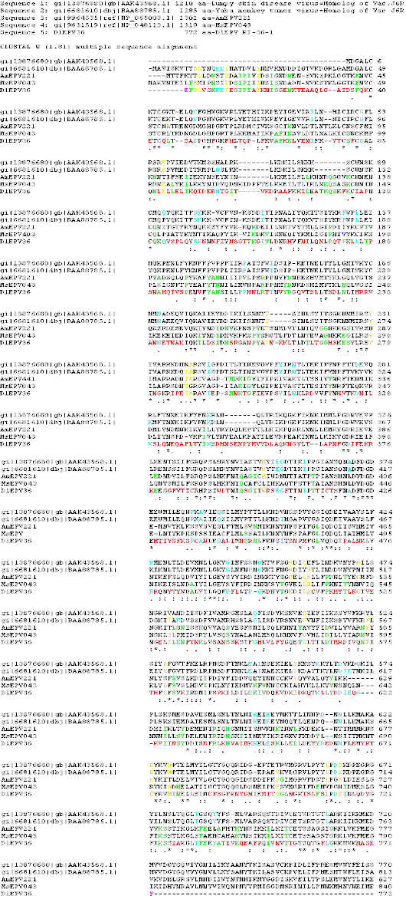
Data Slides
Here is something important…..
AATGCTGATTTTGATGGAGATGAG
So: No, No, No – bad idea – if you have to tell the audience “..I know you can’t read this….but….” - don’t show it. The previous slide is a totally unacceptable slide – modify it as shown!!
<number> of <number>

Slide 38
How Many Slides?
Rule of thumb: 1 slide per minute of your allotted time
You will spend longer on some slides than you think.
For a 20-minute talk, use 20 slides. If you fill up your 20 minutes, there is no time for questions.
Don’t you hate being the last speaker in a session where everyone has gone 5 minutes over and your 30-minute talk now has 15 minutes left? Don’t do that to other speakers!!
<number> of <number>

Slide 39
Answering Questions
Listen carefully to the question.
Do not interrupt or finish the question for the questioner.
Repeat the question for the audience if necessary in short form.
If you don’t know the answer or how to approach, ask for more guidance.
  e.g. “I am not sure I understand the question, could you elaborate.”
If you then do not know the answer, don’t ramble, try this:
  “I am not sure, but one possible reason might be….”
  “I’d be happy to get back to you with the answer to your question after I do some research on the issue”
You can also shift the responsibility to your supervisor/boss if you are not sure what to do.
  e.g. “Perhaps Professor X can answer that better than I”
NEVER argue with questioners…if they become really “pushy” and are being difficult just say.
  “That’s very interesting, perhaps we can talk about this after the seminar”
  You always have the option of simply saying
  “I’m sorry, I don’t know the answer to your question at this stage!”
<number> of <number>

Slide 40
Summary
A good presentation requires much preparation.
Make a proper introduction and use a slide that shows the structure (outline) of your talk.
Have slides that are clean, clear, and readable.
Use approximately 1 slide per minute.
Show a summary slide at the end.
Make the final slide an acknowledgement slide.
Add a few extra slides AFTER your last slide to use in case questions arise in areas you think might be useful.
Conclude by saying : “Thank you very much for your attention.” Stop and let the audience clap!!!
Do NOT ask for questions unless there is no chairperson!!!!!!!!
<number> of <number>

Slide 41
Thank you !
<number> of 41

